Slide 1


Python Basics Level: Fundamental

Slide 2
Course Overview
Sections | Topics
Introduction to Python | Overview- What & Why Python Interpreter Anaconda Indentation & Commenting
Basic Operations and Variables | What are variables Basic Operations Control Flow, Conditional Statements & Loops More on K-means
Basic Datatype and structures in Python | Lists & List Methods Dictionaries Tuples Arrays DataFrames
Various Functions in Python | Functions, Built in functions & import functions Global vs Local scope File Handling in Python Data Science in Python Data import, manipulation and aggregation
Appendix | Keywords, operation precedence and use cases

Slide 3
Introduction to Python
What is Python and why is it used?
How does a Python interpreter work?

Slide 4
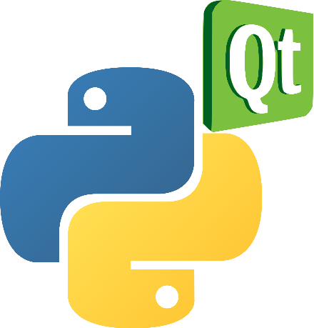

Introduction to Python - What & Why
Introduction to Python
Python was created by Guido Van Rossum in 1989 named after “Monty Python”
It’s a multi purpose, interpreted, dynamically typed, object-oriented, easy to use and high level programming language
An interpreted language, which means there is no need of code compilation
Supported by many modern operating systems (Windows, Mac, Linux, Android, iOS, etc.)
Has been used to build massively scalable applications like YouTube and much of Googles internal infrastructure

Slide 5


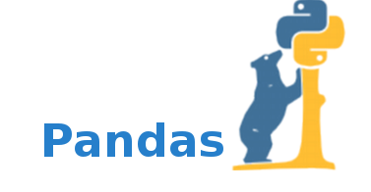
Introduction to Python - What & Why
Introduction to Python
It’s the preferred language on Big data platforms because of wide set of libraries available for big data processing
It also has huge number of libraries for deep learning, image processing etc.
Python libraries used for different applications like:
Make useful plots using matplotlib
Build a graphical user interface (GUI) using PyQt
Scientific computing using NumPy
Web development using Django
Python bindings are available for many popular APIs: Google services, Amazon AWS, etc.,c

Slide 6
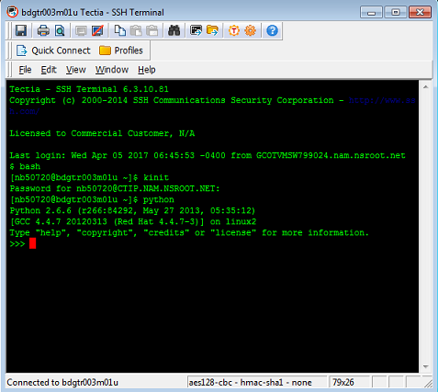
Python Interpreter
How to use Python?
Python Interpreter reads and executes commands interactively
Interpreter runs the code ‘line by line’ and checks for any errors
We can either run the instruction by instruction of a code or run entire code altogether by passing a script
The line “#!/usr/bin/env python” in the start of code can be used to run python code in Unix.
Python scripts have the extension .py, meaning that the filename ends with .py (Ex: helloworld.py). To run the script, we simply write python helloWorld.py at the command prompt.

Slide 7

Anaconda
Indentation & Commenting
Anaconda is a Python distribution that is particularly popular for data analysis and scientific computing
Open source project developed by Continuum Analytics, Inc.
Available for Windows, Mac OS X and Linux
Includes many popular packages: NumPy, SciPy, Matplotlib, Pandas, IPython, Cython
Includes Spyder, a Python development environment
Includes conda, a platform-independent package manager
Anaconda is easy to install
Download installer from https://www.continuum.io/download
Execute the installer and follow the instructions

Slide 8
Indentation & commenting of codes
Indentation & Commenting
Python uses whitespace indentation to delimit blocks – rather than curly braces or keywords
Often a colon appears in the start of a new block followed by indentation till the end of the block
Whitespace is the space on left side for each line within the block
Within a block of code each line should be indented by same amount and decrease in indentation signifies end of current block
Comments are helpful for better understanding of code
In Python if line starts with “#” interpreter treats the line as commented and will ignore while execution
For the multiline comments enclose all the lines to be commented in “””
# single line commenting - importance of indentation
"""multiple line commenting
Example for importance of indentation
""“
def spam(): # inline comments
eggs = 12
return eggs
Print (“abc”)

Slide 9
Basic Operations and Variables
What are variables and how to use them?
What are the types of operators in Python?
What are loops and how to use them?

Slide 10
Variables
Variables let you keep track of things while programming
A variable is used to store data of any datatype
Different data types that Python support include int, float, strings, Boolean, nulls, lists, dictionaries, tuples
E.g. of different datatypes: 1, 2.0, “hai”, True, None, [1,2,3], {1:”hai”}, (1,2,3)
Python has reserved key words which can’t be used as variable names (given in Appendix for reference)
Variable name shouldn’t start with numbers and can contain numbers, underscores, letters
E.g. of invalid variable names: 1foo, debt rate, char etc.,
E.g. of valid variable names: f_dt, fe2, fast
#Boolean
b = True
Print (b)
# Output: True
type(b)
# Output: <type ‘bool’>
#Integer #Integers can be of any length, it is only limited by the memory available
a = 1234567890123456789
a
# 1234567890123456789
#Float
b = 0.1234567890123456789
b
# 0.12345678901234568 #Note that float is truncated as floating point number is accurate up to 15 decimal places.
#Complex number
c = 1+2j
c
# (1+2j)

Slide 11
Variables
More on Variables
Unlike other programming languages declaring the datatypes of the variables is not required in Python
The value of a variable can be reassigned at any point of the code
The type of a variable can be found by using type( “variable name”)
Type of a variable can be changed by using datatype(variable)
#string datatype
a = "wall-e"
print (a)
# Output: wall-e
print(type(str(12)))
# Output: string
Python is a case sensitive language and it interprets same variable name in lower and upper case as different variables

Slide 12
Type of Operators
Basic Operators
Operators | Descriptors | Example
Arithmetic Operators | Mathematical operators like +, - ,/ .etc | a = 3+2
Relational Operators | Tests for relation between two variables like > ,< ,==, >= , <= | If a>3 Print (a)
Assignment Operators | Assigns value of right side variable to left side variable / value | a = 2
Logical operators | Logical AND (and) , Logical OR (or), Logical NOT (not) operators | (a <= 2) and (not(a+2 == 4))
Bitwise operators | Binary bitwise comparison of bit patterns of equal length Bitwise operators include & , |, ^, ~, <<, >> | 4 & 2
* List of operators and their precedence given in Appendix

Slide 13
Control flow is the order of execution of instructions
Control Flow
Control flow is the order in which the program’s code executes
Control flow in python is regulated by conditional statements, loops and function calls
If and elif statements are conditional statements used for branching of code
Syntax: if condition:
code block
elif condition:
code block
Range function generates sequence of numbers used to iterate over with ‘For’ loops
Syntax: range([start], stop, [step])
#age.py
age = input("enter your age: ")
if age < 15:
print ("Child“)
elif age < 30:
print ("Young“)
elif age < 45:
print ("Senior“)
else:
print ("Old“)
# Input: enter your age: 40
#Output : Senior
range(0, -5, -1)
# Output: [0, -1, -2, -3, -4]

Slide 14
Loops help in iterating same code multiple times
Loops
For loops help in executing a block of code multiple times without necessity of rewriting it again
For loop is commonly used in conjunction with “in” operator and “range()” function
While loop executes a block indefinitely until given condition is satisfied or control statement is used
Continue – Continue with next iteration of loop without completing current iteration.
Break – Breaks out of the smallest enclosing for or while loop
# compute sum of numbers 1-10
sum = 0
for x in range(1, 11):
sum += x
print (sum)
#Output: 55
x = 0
while (x < 7):
x += 1
if x == 3:
continue
print (x)
if x == 5:
break
#output
1
2
4
5

Slide 15
Basic Datatype and structures in Python
What are lists?
What are methods and how to use them?
Introduction to Tuples, Dictionaries and Arrays
Dataframes in Python

Slide 16
Data Structures
Lists are most common data structure used in python
Lists are used to store ordered collection of items and can contain any data type
Each item in list can be accessed by their index value and indexing in Python starts with zero
Negative indices can be used to access list starting with the last element
Multiple items in list can be accessed by giving range of numbers as index
a = [5, 3, -2, 7, 0]
b = [1, 2, 4, 5, 1]
print (a[0])
#Output: 5
print (a[2:])
# Output: [-2, 7, 0]
Concatenate
print (a + b)
# Output: [5, 3, -2, 7, 0 , 1, 2, 4, 5, 1]
Repetition
print (['I'] * 2)
#Output: [‘I’,’I’]
Min & Max
print (min(a))
# Output: -2
Length
print (len(a))
# Output: 5

Slide 17
Data Structures
Methods helps in efficient utilization of lists
Methods makes working with lists easier and efficient
Syntax for calling any method on object x is: x.sort() Few common routines include :
append(x) – add a single item to the end of the list.
extend(x) – add all the elements in list x to the end of the list.
sort() – sort the list (defaults to ascending order).
reverse() – reverse the order of the list’s elements.
Remove(obj) – remove the obj
Index(obj) – return the index of first obj match in list
Count(obj) – count the number of times obj appears in list
Pop(n) – remove item at given position and return it
Insert(n,obj) – insert the obj at given position
Del list[n] – delete item at given position
a = [5, 3, -2, 7, 0]
print (len(a))
# Output : 5
a.sort() # a.sort(reverse = True) for desc
print (a)
# Output : [-2, 0, 3, 5, 7]
a.reverse()
print (a)
# Output : [7, 5, 3, 0, -2]
a.append([1,2,3])
print (a)
# Output : [7, 5, 3, 0, [1,2,3]]
a.extend([1,2,3])
print (a)
# Output : [7, 5, 3, 0, 1,2,3]
del a[0]
print (a)
# Output : [ 5, 3, 0, 1,2,3]

Slide 18
Data Structures
Dictionary stores a set of key/value pairs
Dictionaries are data structures which have key and value pairs enclosed within curly braces and are colon separated
Keys are unique within the dictionary while values need not be
Values can be of any data type but keys should be immutable data types that means it cannot be dynamic like lists
Values in dictionary can be accessed by enclosing key within square brackets
Dictionary can either be updated by adding a new key, value pair or changing value of existing key
dict = {'Name': 'Zara', 'Age': 7, 'Class': 'First'}
print dict['Name']
Print dict
dict[‘Age’] = 8
print dict[‘Age’]
Delete a dictionary
dict.clear() # clears the entire dictionary
To find if a key is present
dict.has_key(key) # returns True if the key is in dictionary else false
Get list of keys
dict.keys() # returns all keys in the dictionary
Get list of values
dict.values() # returns values in the dictionary

Slide 19
Tuples are similar to lists but cannot be modified once created
Data Structures
Tuples are sequence of Python objects enclosed within parenthesis
Parenthesis is optional but its good practice to use it
Elements in tuples can be accessed similar to lists using index values enclosed within square brackets
Tuple is immutable which means its values cannot be modified directly
Individual items in tuple can not be deleted where as whole tuple can be deleted
Basic operations like len(), concatenate , repetition , looping can be applied on tuples similar to lists
t = 12345, 54321, 'hello!'
t[0] a
# Output : 12345
# Tuples may be nested:
u = t, (1, 2, 3, 4, 5)
print (u)
# Output : ((12345, 54321, 'hello!'), (1, 2, 3, 4, 5))
singleton = 'hello’, # <-- note trailing comma
print (singleton)
# Tuples are immutable:
t[0] = 88888
# Output :
Traceback (most recent call last):
File "<stdin>", line 1, in <module>
Type Error: 'tuple' object does not support item assignment
# but they can contain mutable objects:
v = ([1, 2, 3], [3, 2, 1])

Slide 20
Data Structures
Arrays are similar to lists but faster in numerical operations
Arrays are similar to lists but each element in Array should be of same datatype typically a numeric type like int or float.
Accessing, slicing, manipulating Arrays is just like Lists and lists can be converted into Array as well
Arrays make operations with large amounts of numeric data very fast and are generally much more efficient than lists
NumPy package is used to generate and manipulate Arrays in Python
Although ndarrays expose multi-dimensional indexing, their contents are actually stored in a linear index
Accessing Elements
import numpy as np
a = np.array ( [ [1, 2, 3, 4], [1, 2, 3, 4] ], float) #converting list into Array
print (a)
print (a[1,:]) # Accessing entire Row of Multidimensional array
Dimensions
print (a.shape)
Array Operations
print (a + a) # Similar to this other math operators can be applied
print (a.mean()) # Similarly avg, max, min, var, product can be applied on all elements
print (np.logical_and ( a > 2 , a<3)) # Logical or and logical not can also be applied
Data Manipulation using Arrays
print (np.where (a != 3, 1, a)) # value is assigned 1 if exp is true else retain array value

Slide 21
Data Structures
Dataframes are similar to SQL tables
DataFrame is 2-dimensional labeled data structure i.e., data is aligned in a tabular fashion in rows and columns
Along with the data, you can optionally pass index (row labels) and columns (column labels) arguments
Dataframes can be generated using dicts, lists, ndarrays, Series or another DataFrame
DataFrame can be created and manipulated using Pandas library
Pandas library can be installed using the command pip install pandas and then import it whenever needed using the command import pandas
Syntax: DataFrame( data= Data , index= rowlables , columns = columnnames)
More on DataFrames http://pandas.pydata.org/pandas-docs/stable/generated/pandas.DataFrame.html
Creating a DataFrame
df = DataFrame( np.random.randn(10,5), columns = list('data‘) ) # column labels can also be used to access data
Dimensions of DataFrame
df.shape # Displays the rows, column count
Accessing by Row Labels
df.loc[1:5:2] # .loc[start_pos:stop_pos:step] row labels
Creating new column
df[‘z’] = range( 1, 11) # New column should have same length as index DataFrame
Sorting
df.sort_values(by = 'z', ascending = True) # Sorting by column values

Slide 22
Various Functions in Python
What are functions?
Python Built-in functions
File operations in Python
Data science in Python
Data import and manipulations
Data Aggregations

Slide 23
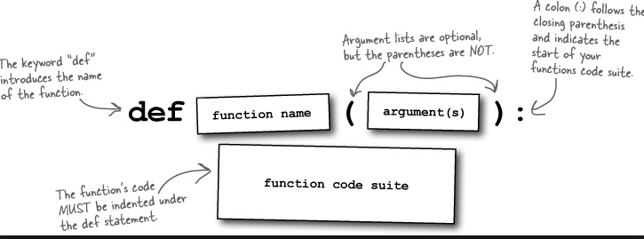
Function is a block of code that can be reused
Functions
Function is a block of code that can be reused to perform a single certain action
The code block within every function starts with a colon : and should be indented
A function may have zero or more inputs and can either return a value or none
Return is used to exit a function, optionally passing back an expression to the caller
Function can be called in other function or directly by its name followed by “()”
Syntax: function_name(param1, param2,..)
Function starts with def and followed by parameters are enclosed with in the parenthesis
Syntax : def function_name (param1, param2, ..):
code block
return

Slide 24
More on Functions
Functions
In python parameters are passed by reference that means if the value of parameter is changed in function it will be reflected outside of the function as well
Global Variables: Variables that are defined within a function are called local variables and those that are defined outside have a global scope
Local Variables: Variables that are defined within a function can be accessed only inside the function they are declared
def Func(a): # defining a function
b = 2 * a # b is a local variable
return b
x = Func(10) # x is a global variable
y = Func(20) # Function calling
print (x)
print (y)

Slide 25
Python has built in functions & can import additional packages
Functions
Python has built in functions like input(), print(), len(), str() etc.., which are used for basic functionalities
A full list of built-in functions can be acquired from : https://docs.python.org/2/library/functions.html
Python also has import option for using functions from other libraries, use import <library name> and any function could be called using <library name>.function()
Python has wide set of libraries which are used for data science applications, web applications, web frameworks, statistical analysis
Python is widely used in big data world due to wide set of data processing libraries and easily integrate with web applications
Prominent data science Python libraries include Numpy, SciPy, pandas, nltk, theanos, statsmodel,sklearn etc.,
# built in functions
a = input("Enter value of a :")
b = a +3
print (b)
#Output:
Enter value of a : 3
6
print(len([1,2,3]))
# Output : 3
# importing libraries in python
import math
p = math.pi
r = 10
print (p * math.pow(r, 2))
# Output : 314.159265359
print (2 * p * r)
# Output : 62.8318530718

Slide 26
Python provides extensive file operations in various modes
File Handling
Python enables the user to read any external file like how a notepad editor would read a file and perform operations on it that vary from as basic as finding if a particular word is present or not to complex statistical models to identify patterns in documents
To read or write a file should be opened using built-in open() function and default mode is read
Syntax : file object = open(file_name [, access_mode] [, buffering])
file_name – Contains the name of the file that you want to access
access_mode - read (r), write (w), append (a)
Buffering – enable buffer (1), no buffering takes place (0)
Sr. No | Access modes | Purpose
1 | w | Used for writing to files If the file is not present, it creates a new file else overwrites the file
2 | r | This mode is used for reading files This is the default mode
3 | rb | Used for opening the file to read only in binary mode
4 | w+ | This mode is used to both read and write a file
5 | a | This mode is used to append to a file instead of overwriting as in ‘w’ mode The cursor is at the end of the file

Slide 27
Python allows changes to the directories to support file handling
File Handling
Sr. No | Function | Purpose
1 | os.rename(current_file_name, new_file_name) | Renames the file given as the first parameter to the second parameter
2 | os.remove(file_name) | Deletes the file specified in the parameter
3 | os.mkdir(foldername) | The function creates a new directory specified as the parameter
4 | os.rmdir('dirname') | The function is similar to that of remove() While remove() deletes files, rmdir() deletes directories specified as parameter
5 | Os.chdir(‘newdir’) | Change the current directory to specified directory
6 | Os.getcwd() | Displays current directory
7 | File.write(“string”) | Writes string to opened file
8 | File.read(n) | Used to read n number of bytes from opened file
9 | File.tell() | Used to return the current position of cursor in file

Slide 28
Data Science using Python
Python Data Science
Following are the fundamental and prominent data science libraries in Python :
NumPy:
NumPy open source fundamental scientific computing Python library that provides basic routines for manipulating large Arrays faster
Syntax import numpy as np
More on NumPy http://www.numpy.org/
Pandas:
Pandas is an open source library providing high-performance, easy-to-use data structures and data analysis tools for the Python programming language
Pandas provides a fast and efficient DataFrame object for data manipulation with integrated indexing
Pandas also provides functionalities like Aggregating data using group by, merging datasets, missing data handling, label based slicing, fancy indexing and subsetting of large datasets
Syntax import pandas as pd
More on Pandas http://pandas.pydata.org/

Slide 29
Data Science using Python
Python Data Science
Following are the fundamental and prominent data science libraries in Python :
Matplotlib:
Matplotlib is a Python 2D plotting and visualization used for generating scatter plots, histograms, bar charts, etc.,
Syntax: from matplotlib import pyplot as plt
Scikit-learn:
Scikit-learn supports both supervised and unsupervised learning like classification, regression, clustering, model selection, dimensionality reduction and preprocessing
Syntax: from sklearn import <sub pacakge>
Statsmodels:
It provides functions for statistical models as well as conducting statistical tests and various statistics
Syntax: import statsmodels as sm

Slide 30
Import data & Data manipulations
Python Data Science
Importing data using csv files
import pandas as pd # import Pandas module for dataframe routines
df = pd.read_csv("height_gpa.csv")
View the data
df.head(10) # Displays the top 10 records
df.tail(10) # Displays bottom 10 records
Attributes of the data
df.index() # Row labels
df.columns() # Column labels
Summary statistics of the data
df.describe() # Summary statistics like min, max, mean etc., for columns
Count of Non Null values
df.count() # Prints out count of non null records
Selection & Dropping
df[‘d’] # Selecting by using Column labels
df[1:3] # Selection by Row labels
df.drop[‘d’, axis = 1, inplace = True) # in place specifies to replace original data

Slide 31
Aggregating & Transforming Data
Python Data Science
Check for missing values
df.isnull() # Checking for the missing values in Data
Filtering Data
df[df[‘d’] >.01] # Filtering Data using conditions
Merging the Dataframes
pd.merge(df, df, how='inner', left_on = [‘d'], right_on = [‘d']) # Merging Datasets
Group By
df.groupby(‘d’).sum() # Grouping and Aggregating the columns
Statistics
df.mean() # Mean, Median, Variance on each column
Apply
df.apply(lambda df: df.max() - df.min()) # Applying User Defined Functions (UDF) to individual column
Exporting the files
df.to_csv(‘mydata.csv’) # Exporting the results as csv files

Slide 32
Appendix

Slide 33
Python Operators precedence
Operating Precedence
Operator | Description
** | Exponentiation (raise to the power)
~ , + , - | Complement, unary plus and minus (method names for the last two are +@ and -@)
* , /, %, // | Multiply, divide, modulo and floor division
+ , - | Addition and subtraction
>> , << | Right and left bitwise shift
& | Bitwise 'AND'
^, | | Bitwise exclusive `OR' and regular `OR'
<=, <, >, >= | Comparison operators
<, >, ==, != | Equality operators
=, %=, /=, //=, -=, +=, *=, **= | Assignment operators
is, is not | Identity operators
in, not in | Membership operators
not, or, and | Logical operators

Slide 34
Built-in functions in Python
Built-in Functions
Function | Description | Category
id() | Determine memory location of object | Informational
input() | Query user for input | Interaction with user
int() | Convert input to int | Typecasting
float() | Convert input to float | Typecasting
len() | Determine the length of a list/string/etc. | Tool
print() | Print something to the user | Interaction with user
range() | Returns a list of integers | Tool
str() | Convert input to string | Typecasting
upper() | Converts string to uppercase | Tool
type() | Determine type of object | Informational

Slide 35
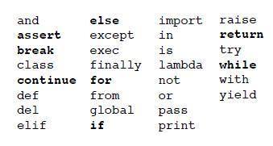
Python Keywords
Keywords
The following identifiers are used as reserved words, or keywords of the language, and cannot be used as ordinary identifiers

Slide 36
Example : Game involving the player and an enemy
Example: Dictionaries
A dictionary is a great way to count unique elements
Dictionary is used to keep track of each character’s attributes
Game.py
# set up characters
player = {'health': 50, 'damage': 300, 'armor': []}
enemy = {'health': 250, 'damage': 200, 'armor': ['Laser Armor']}
# fight!
if player['damage'] > enemy['health']:
print ("player wins!“)
elif enemy['damage'] > player['health']:
print ("player loses!“)
else:
print ("stalemate!“)
Output
> python Game.py
player wins!

Slide 37
Example - Defining Pythagoras Theorem As A Function
Example : Functions
A function may have as many inputs as you like
The Pythag function has two inputs (two sides of a right triangle)
Pythag.py
import math
def Pythag(a, b):
c = math.sqrt(a ** 2 + b ** 2)
return c
sideA = input("enter side a: ")
sideB = input("enter side b: ")
sideC = Pythag(sideA, sideB)
print ("side c is: " + str(sideC))
Output
> python Pythag.py
enter side a: 3
enter side b: 4
side c is: 5.0

Slide 38
File handling use case – Finding the frequency of words
Example: File Handling
Input.txt
Hello world of python
This is my first python program
Code
Output
file=open(“Input.txt")
wordcount={}
for i in file:
for j in i.split():
if j not in wordcount:
wordcount[j] = 1
print (wordcount)
else:
wordcount[j] += 1
print (wordcount)
for k,v in wordcount.items():
print (k,v)
python 2
of 1
is 1
This 1
program 1
World 1
my 1
Hello 1
first 1

Slide 39

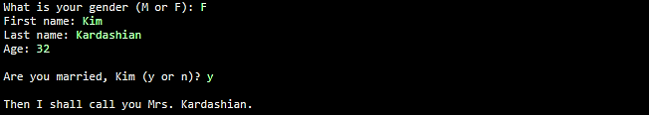
Exercise
Exercise
Make a simple numeric calculator. It should prompt the user for three numbers. Then add the numbers together and divide by 2. Display the result. Your program must support numbers with decimals and not just integers
Make a program which displays an appropriate name for a person, using a combination of nested ifs and compound conditions. Ask the user for a gender, first name, last name and age. If the person is female and 20 or over, ask if she is married. If so, display "Mrs." in front of her name. If not, display "Ms." in front of her name. If the female is under 20, display her first and last name. If the person is male and 20 or over, display "Mr." in front of his name. Otherwise, display his first and last name. Note that asking a person if they are married should only be done if they are female and 20 or older, which means you will have a single if and else nested inside one of your if statements.

Slide 40
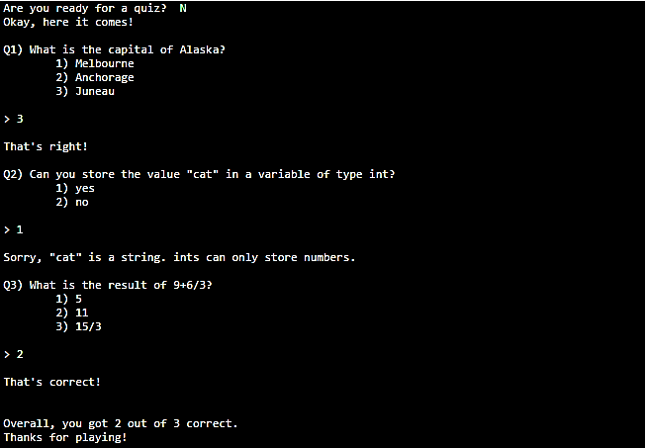
Exercise (Contd.)
Exercise
Write an interactive quiz. It should ask the user three multiple-choice or true/false questions about something. It must keep track of how many they get wrong, and print out a "score" at the end.

Slide 41
Thank you

